Slide 1

Introduction to Altronic labs
TIME TO change the rules again…

Slide 2
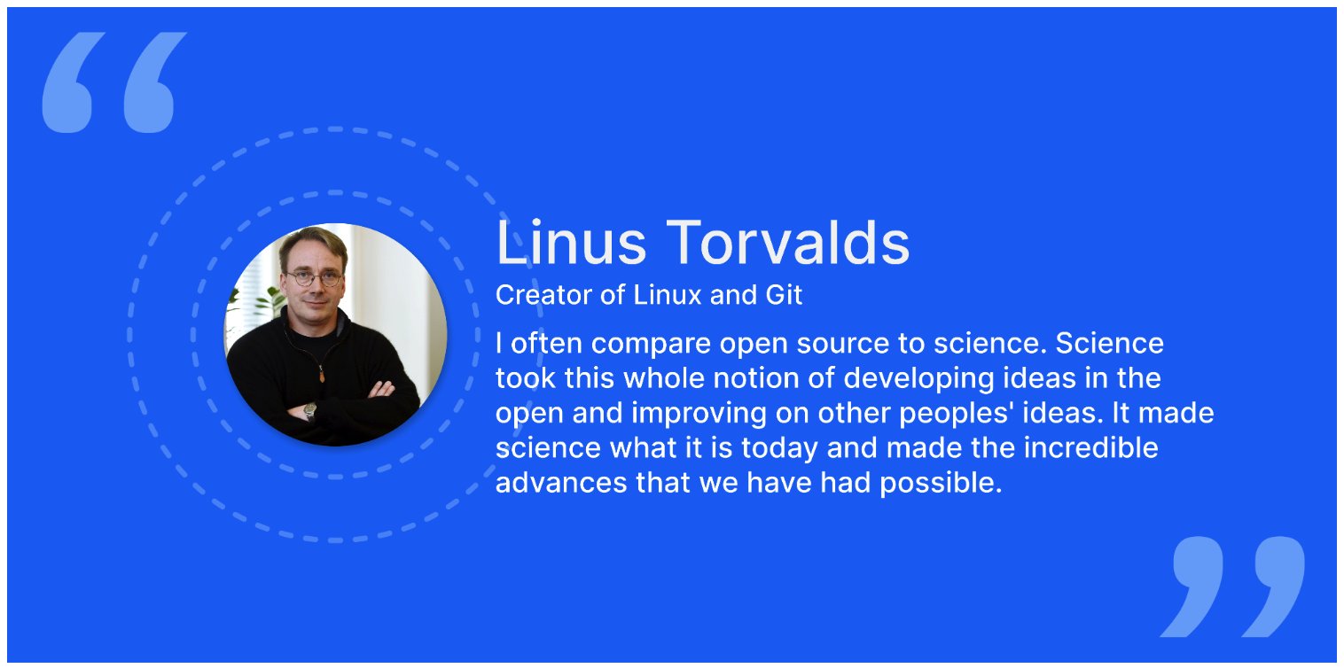

Slide 3


Slide 4
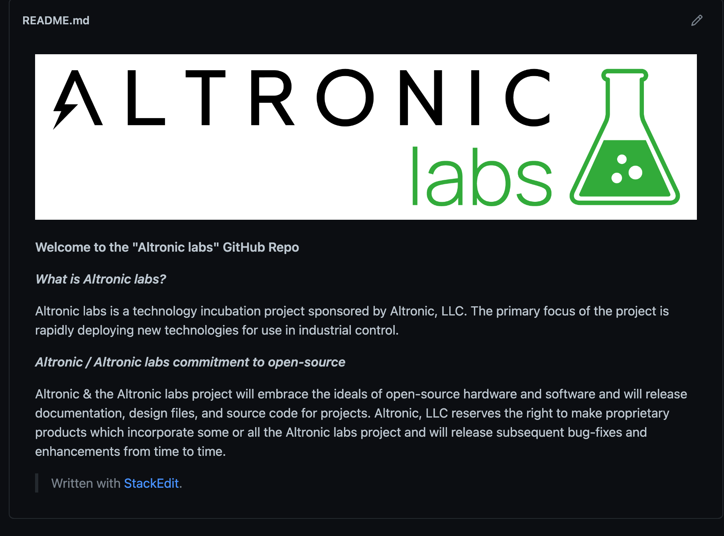

Slide 5
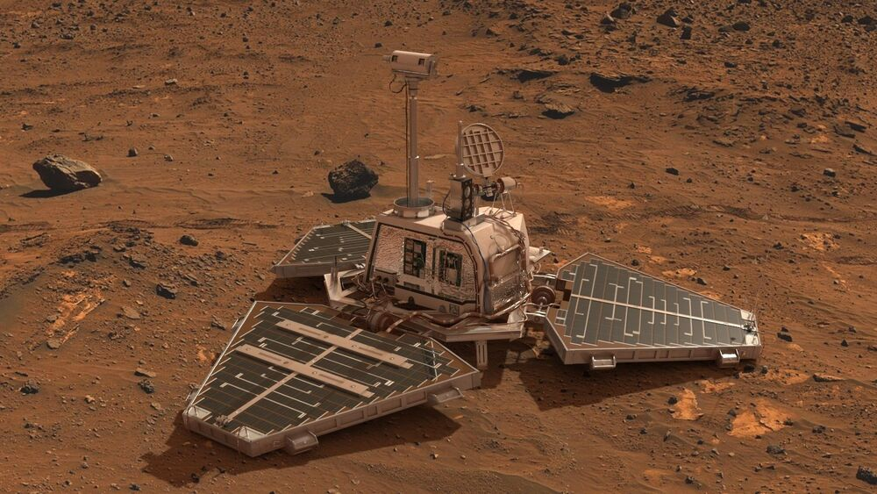


Slide 6
SPRINT #1 – “PATHFINDER”
MARCH 26-31, 2023 – Newark, Ohio

Slide 7
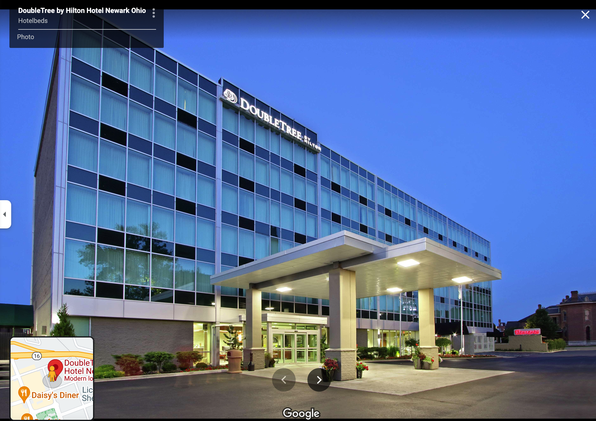
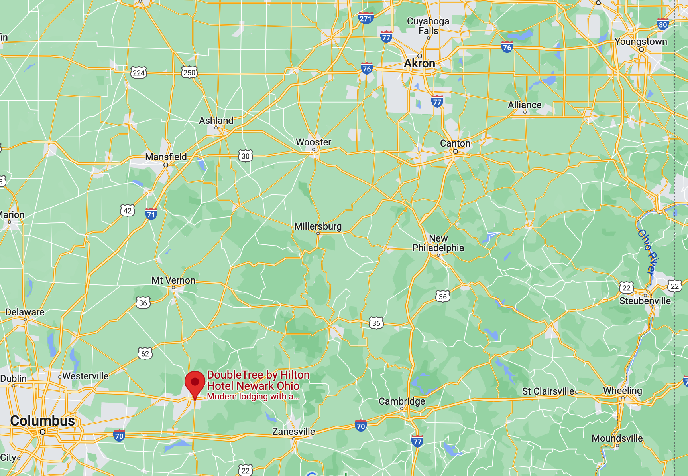
SPRINT #1 – “PATHFINDER”
MARCH 26-31, 2023 – Newark, Ohio

Slide 8
SPRINT #1 – “PATHFINDER”
MARCH 26-31, 2023 – Newark, Ohio
Altronic labs - Sprint 1 - "Pathfinder"
Sunday | Monday | Tuesday | Wednesday | Thursday | Friday
3/26/23 | 3/27/23 | 3/28/23 | 3/29/23 | 3/30/23 | 3/31/23
 | Breakfast (on-site) | Breakfast (on-site) | Breakfast (on-site) | Breakfast (on-site) | Breakfast (on-site)
 | Working Session (8:30-12:00) | Team Building Event - off-site, "Applied Mathmatics" | Working Session (8:30-12:00) | Working Session (8:30-12:00) | Working Session (8:30-12:00)
Arrival Doubletree by Hilton - Newark, OH (3:00PM) | Lunch (12:00-1:00) |  | Lunch (12:00-1:00) | Lunch (12:00-1:00) | Closing (12:00-12:30)
Opening Dinner - tbd. | Working Session (1:00-7:00) | Working Session (4:00-7:00) | Working Session (1:00-7:00) | Working Session (1:00-7:00)
 | Dinner - tbd. | Dinner - tbd. | Dinner - tbd. | Closing Dinner - tbd.

Slide 9
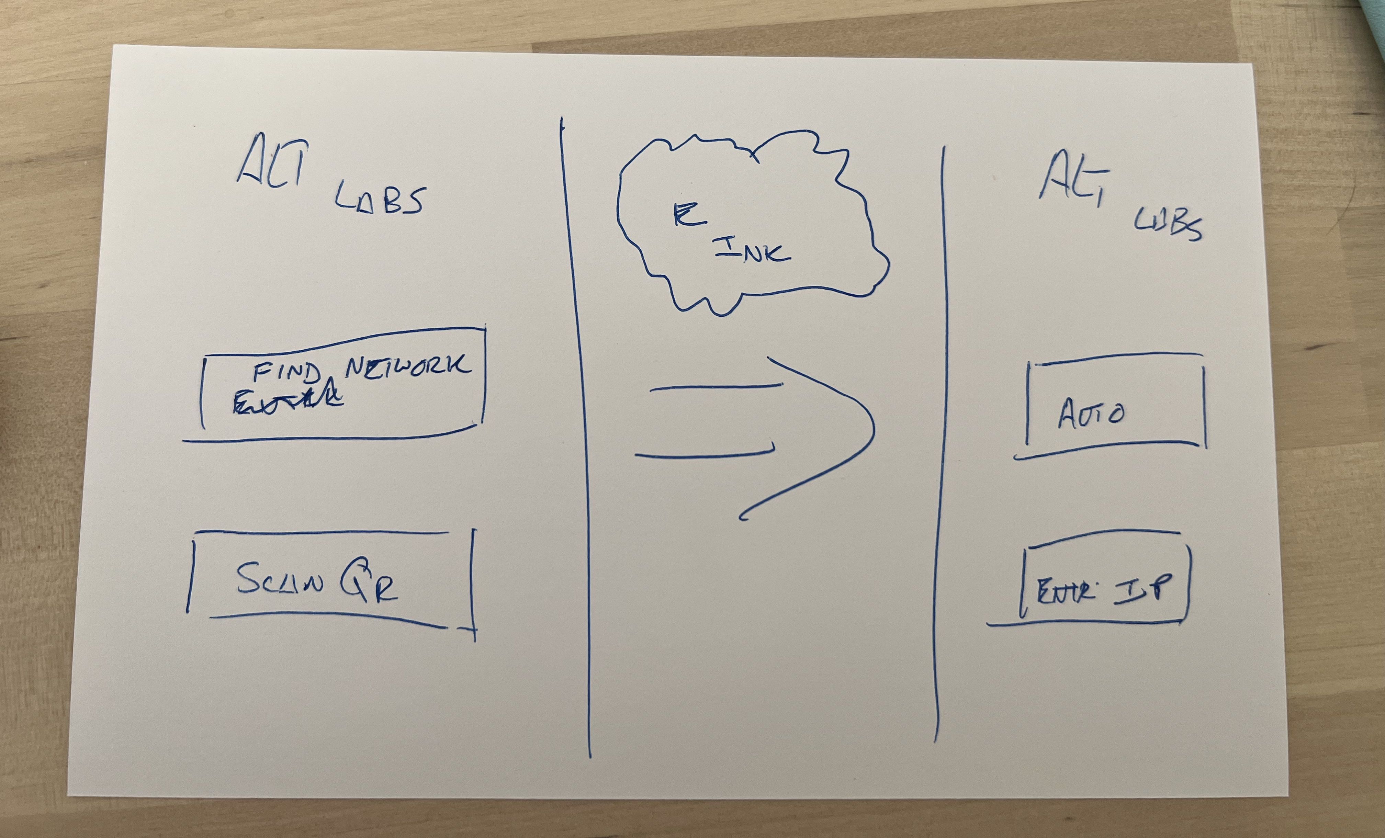
SPRINT #1 – “PATHFINDER”
MARCH 26-31, 2023 – Newark, Ohio

Slide 10


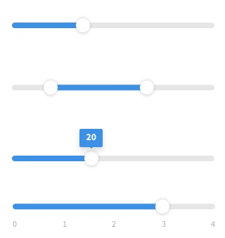






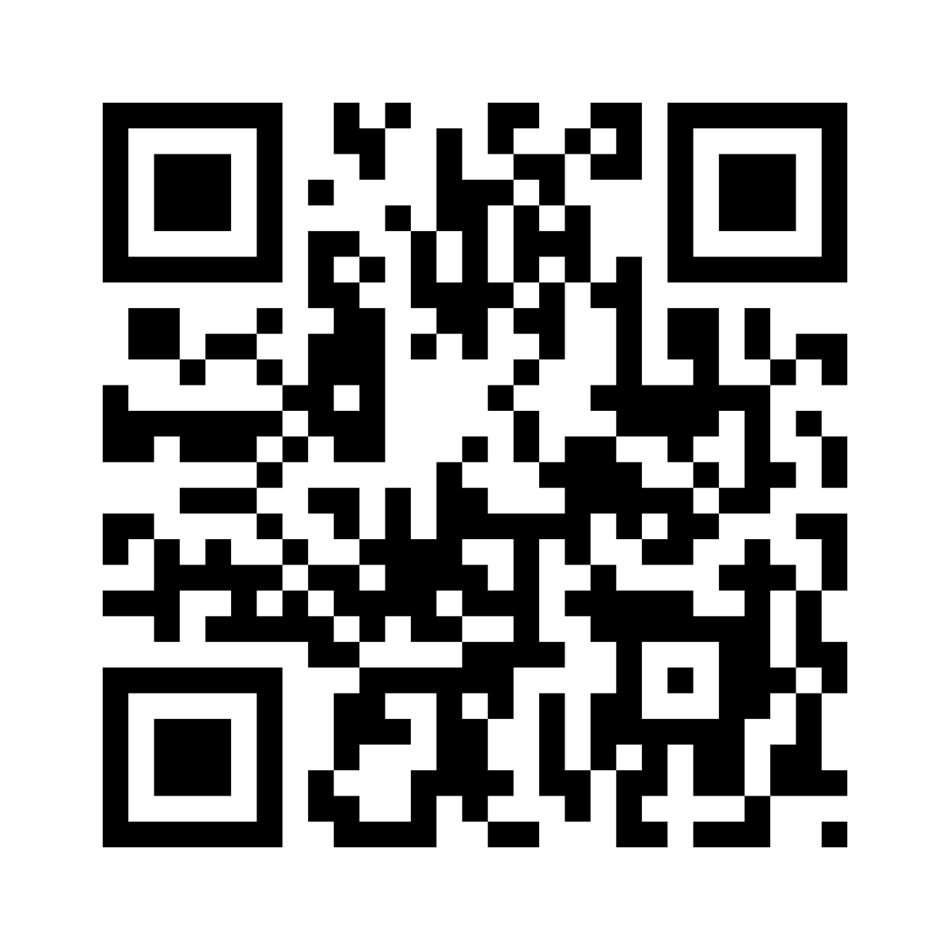

SPRINT #1 – “PATHFINDER”
MARCH 26-31, 2023 – Newark, Ohio
EMBEDDED HARDWARE PLATFORM
MOBILE APP
LIBRARY/API FOR WIFI/QR

Slide 11
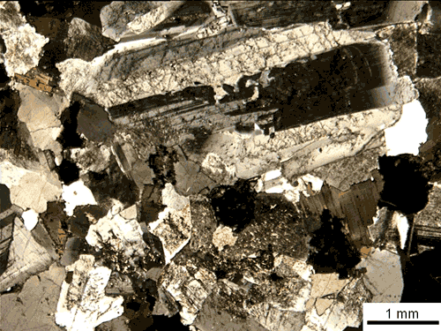

Hardware Fireteam - ”Bedrock”
HARDWARE PLATFORM
WIFI/E-INK/INTERFACES
HARDWARE DERIVATIVE
ALTRONIC SAVeS
MEMS IMU/ACCELEROMETER
Open-Source
Component
Proprietary
Component

Slide 12

Embedded Fireteam - ”Iris”
EMBEDDED PLATFORM
BSP / API FOR WIFI
EMBEDDED DERIVATIVE
ALTRONIC SAVeS
VIBRATION ANALYSIS
Open-Source
Component
Proprietary
Component

Slide 13
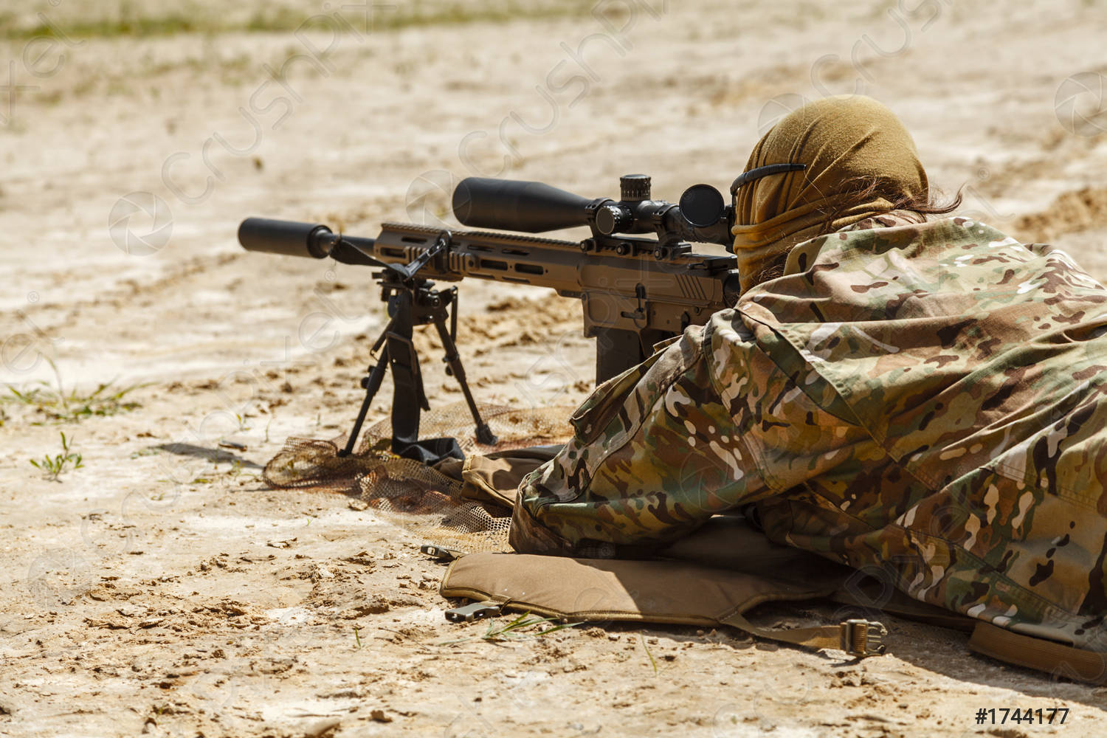
Mobile App Fireteam - ”Overwatch”
iOS/ANDROID APP
CONNECT TO EMBEDDED “UNSIGNED” DEVICES
iOS/ANDROID APP
CONNECT TO SIGNED DEVICES
Open-Source
Component
Proprietary
Component

